Slide 1


Bank of Baroda Hackathon - 2022
Technology Partner
Your Team Name :Creep Access
Your team bio :
Saran S S
Naveena R
Sri Harish M
Sri Sabarish V
Date :20.09.2022

Slide 2
Problem Statement :-
Video Analytics
We interested in Face Recognition Techniques.I already had a thought of doing project
on this case increase Likehood of Crime Prevention.
Theft is a major issue that requires a lot of resources for every bank. A top bank may
receive anywhere from13 to 15 lakhs of cash for clearing on any typical banking day.
Many people's capital and wealth can be impacted by bank theft since they trust banks
to save their money.

Slide 3
User Segment & Pain Points :-
Face Regonization technique in Mobile Phone,Laptop,Security camera.
We had considered developing some additional levels of these face recognition
technique.
Since account holders connected to the banks are most affected, dealing with
current reality of manual bank theft method is becoming ever more common these
days. To protect against unauthorised individuals.
We had thought of adding a few more tiers to our face recognition mechanism to guard
against unauthorized persons.

Slide 4
Pre-Requisite
1.Video Footage Quality :- For example, the type of camera could affect the sort of analysis that is possible with the hardware that is now available, as well as the resolution of video that needs to be processed.
For instance, if a high-resolution camera is positioned at eye level, the video quality and camera placement are probably suitable for recording photos that may be utilised for face matching. This would allow an organisation to use the camera for facial recognition. 2.Video Management Systems :- For live video processing and real-time alerting and video search, you will need a Video Management System (VMS) to support your video content analysis. You may utilize several VMS platforms or a single provider.

Slide 5
3.GPUs for Video Processing :- With the advent of Deep Learning techniques that allow for the identification, extraction, and categorization of video information for analytic applications, video content analysis has significantly advanced over the past several years.
In order to structure video data and analyse its rich metadata, which is then indexed to power video search, dashboard visualizations, and real-time alerts, modern video content analytics solutions rely on GPUs and Deep Learning. 4.Surveillance Deployment Model and Scope :-
An organization's requirements for locally processing twelve hours of video will be very different from those of an organisation that needs to centralise data from tens of thousands of sources constantly.
Your video analytics supplier can collaborate with you to assist your deployment needs and can offer advice on what auxiliary software and hardware would best serve your unique requirements.

Slide 6
Azure tools or resources:-
Azure Video Analyzer.
Azure Video Indexer.
Azure Data Lake Storage.
Azure Analysis Services.
Azure Synapse Analytics.

Slide 7
Any Supporting Functional Documents:-
Methodology:-
Face matching and identification refers to the process of matching and recognising a person's face using pictures and videos that have already been preserved in a database. The model must first be trained on the subject's face before being able to match faces and recognise the subject from different images. Even when the orientation and attitude of the subject's face are changed in photographs, a decent face recognition model has to be able to identify the subject accurately.
Whether the authorised person is engaging in theft prosecution or not, this approach is utilised to detect their facial expression and transmit a warning notice to the main branch and nearby police station.
Four modules make up the suggested approach
Finds the face in an image(Face detection)
2. Analyze and extract facial features
3. Compare the features for the 2 input faces
4. Returns True if face matched or else False.

Slide 8
Key Differentiators & Adoption Plan
There are currently 6 to 7 thefts per day. This technique will help us cut down on stealing in the area.
The safety of the gold and money in the bank can be increased.
It helps in lowering crime rates in the area.

Slide 9
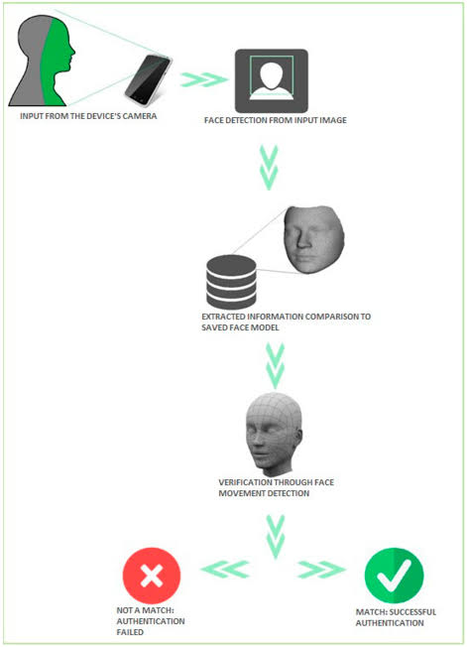
GitHub Repository Link & supporting diagrams, screenshots, if any
.

Slide 10
Thank You
Team member names:-
Saran S S
Naveena R
Sri Harish M
Sri Sabarish V

